Slide 1
DESIGN AND DEVELOPMENT OF A COMPUTER-BASED SALES AND INVENTORY MANAGEMENT SYSTEM USING PYTHON
AKINLADE AYOMIKUN DORCAS
13TH JULY, 2026

Slide 2
Table of Contents
Background of the Study
Statement of the Problem
Aim of the Study
Objectives
Significance of the study
Advantages
Scope of the study
Literature Review

Slide 3
Table of Contents
Methodology
System Architecture
System Modules
Dashboard Visualization
Results and Discussion
Conclusion and Recommendations
Contribution to Knowledge
References

Slide 4
Background of the Study
Inventory is a valuable business asset that requires efficient management.
Many SMEs still use manual record-keeping methods.
Manual systems often result in inaccurate stock records, delayed reporting, and poor decision-making.
Computerized inventory systems improve efficiency through automation and real-time monitoring.
This project integrates inventory control with business analytics to enhance operational performance.

Slide 5
Statement of the Problem
Existing inventory systems face several challenges:
Inaccurate stock records
Human errors during calculations
Difficulty monitoring sales performance
Delayed stock replenishment
Poor financial reporting
Lack of real-time business insights
Time-consuming manual inventory management

Slide 6
Aim of the Study
The aim of this study is to develop a smart inventory management system that automates inventory control, sales analysis, financial reporting, and visualization using Python.

Slide 7
Objectives
To develop an inventory database.
To record product information.
To monitor available stock.
To calculate sales automatically.
To generate receipts for individual sales.
To compute income generated.
To calculate profit earned.
To detect products with low inventory.
To generate graphical reports.
To improve business decision-making.

Slide 8
Significance of the Study
The system benefits:
Small and Medium Enterprises (SMEs)
Retail stores
Warehouses
Pharmacies
Supermarkets

Slide 9
Scope of the Study
The system provides:
Product registration
Inventory monitoring
Sales recording
Income calculation
Profit computation
Low-stock alerts
Dashboard visualization
Business performance reporting

Slide 10
Literature Review
Previous inventory systems focused mainly on:
Manual record keeping
Spreadsheet management
Barcode systems
Radio Frequency Identification (RFID) technologies
Enterprise Resource Planning (ERP)
Research shows that integrating inventory management with data visualization improves business performance and decision-making.

Slide 11
Methodology
Development Methodology
The project followed these stages:
Requirement Analysis
System Design
Database Development
Python Implementation
Testing
Evaluation

Slide 12
Methodology
Programming Language:
Python
Libraries Used:
Pandas
Random
Matplotlib
Development Environment:
Jupyter Notebook

Slide 13
System Architecture
User → Inventory Database → Python Processing Engine → Sales Module → Profit Calculation → Income Calculation → Low Stock Detection → Dashboard Visualization → Reports
User inputs data.
Database stores information.
Python processes transactions.
Dashboard displays reports.

Slide 14
System Modules
Inventory Module: Add products, Update inventory
Sales Module: Record sales, Update stock record, Generate receipts
Profit Module: Calculates profit
Income Module: Computes revenue
Alert Module: Detects low stock
Visualization Module: Displays business reports

Slide 15
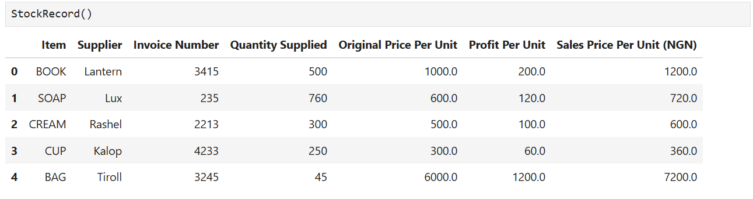
Inventory Module Result

Slide 16
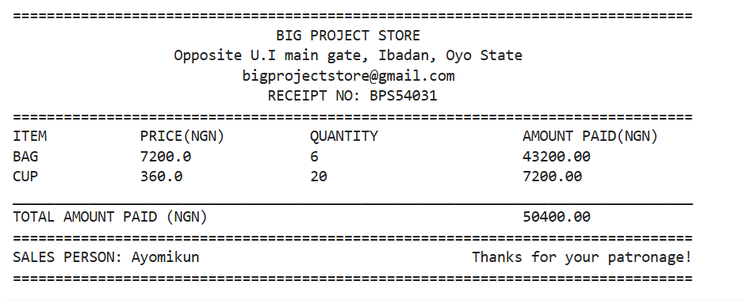
Sales Module Result

Slide 17
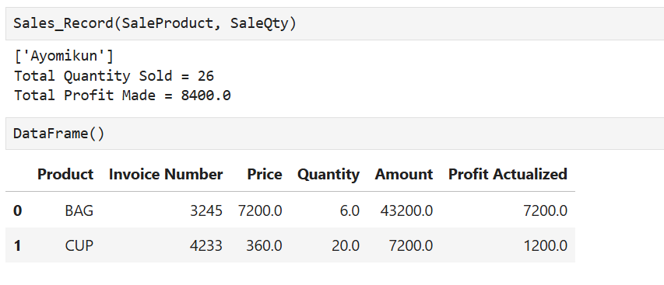
Sales Module Result

Slide 18
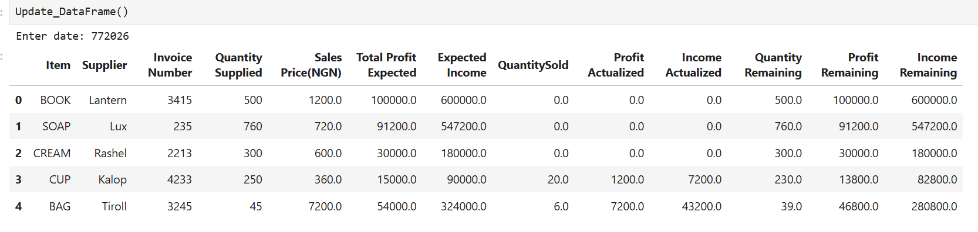
Dashboard Visualization

Slide 19
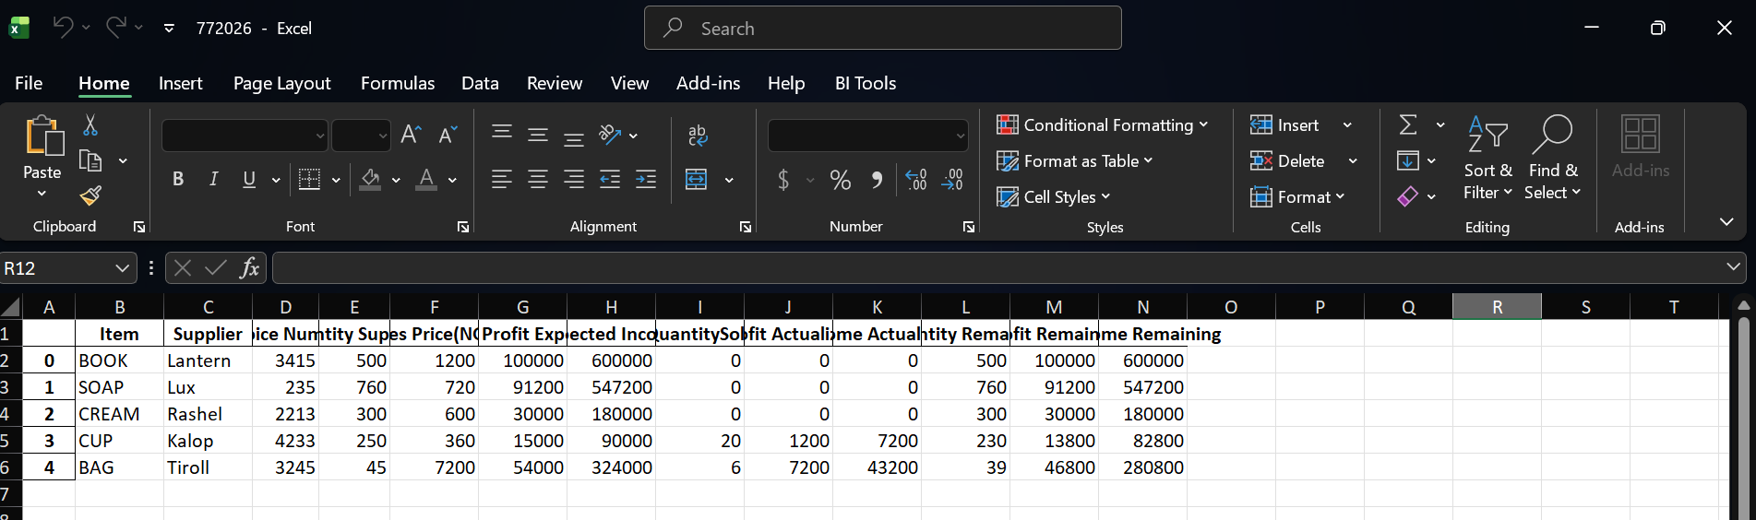
Dashboard in Excel

Slide 20
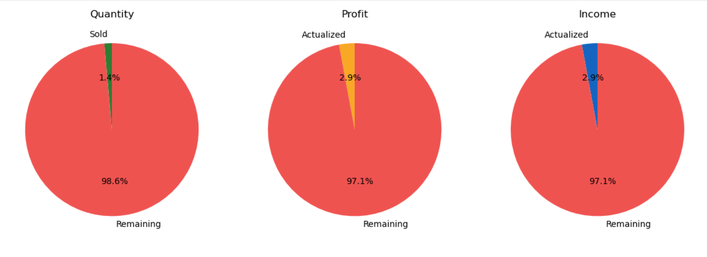
Results and Analysis

Slide 21
Summary
Key Features
Automated inventory management
Sales tracking
Profit computation
Income analysis
Low-stock alerts
Business dashboard
Data visualization
Real-time reporting

Slide 22
Advantages
Accurate inventory records
Faster stock monitoring
Reduced paperwork
Improved productivity
Better financial analysis
Easy business monitoring
Informed decision-making

Slide 23
Conclusion
The system successfully automates inventory operations by integrating stock management, sales analysis, financial computation, and visualization into a single platform.
The system enhances efficiency, minimizes human errors, supports timely inventory replenishment, and provides real-time insights for better business decisions.

Slide 24
Recommendations
Cloud database integration
Barcode scanning
QR Code support
Web-based deployment
Mobile application
Multi-user authentication
AI demand forecasting
Email/SMS inventory alerts
Interactive dashboards (Power BI or Plotly)

Slide 25
Contributions to Knowledge
Developing an affordable Python-based inventory solution
Integrating inventory management with business analytics
Providing automated stock alert mechanisms
Combining inventory, sales, income, and profit analysis in one system
Supporting data-driven managerial decision-making

Slide 26
References
Chopra, S., & Meindl, P. (2019). Supply Chain Management: Strategy, Planning, and Operation (7th ed.). Pearson.
Heizer, J., Render, B., & Munson, C. (2020). Operations Management (13th ed.). Pearson.
Hunter, J. D. (2007). Matplotlib: A 2D Graphics Environment. Computing in Science & Engineering, 9(3), 90–95.
McKinney, W. (2022). Python for Data Analysis (3rd ed.). O'Reilly Media.
Van Rossum, G., & Drake, F. L. (2009). Python 3 Reference Manual. CreateSpace.

Slide 27
Thank You!
Thank you for your attention.

